Slide 1
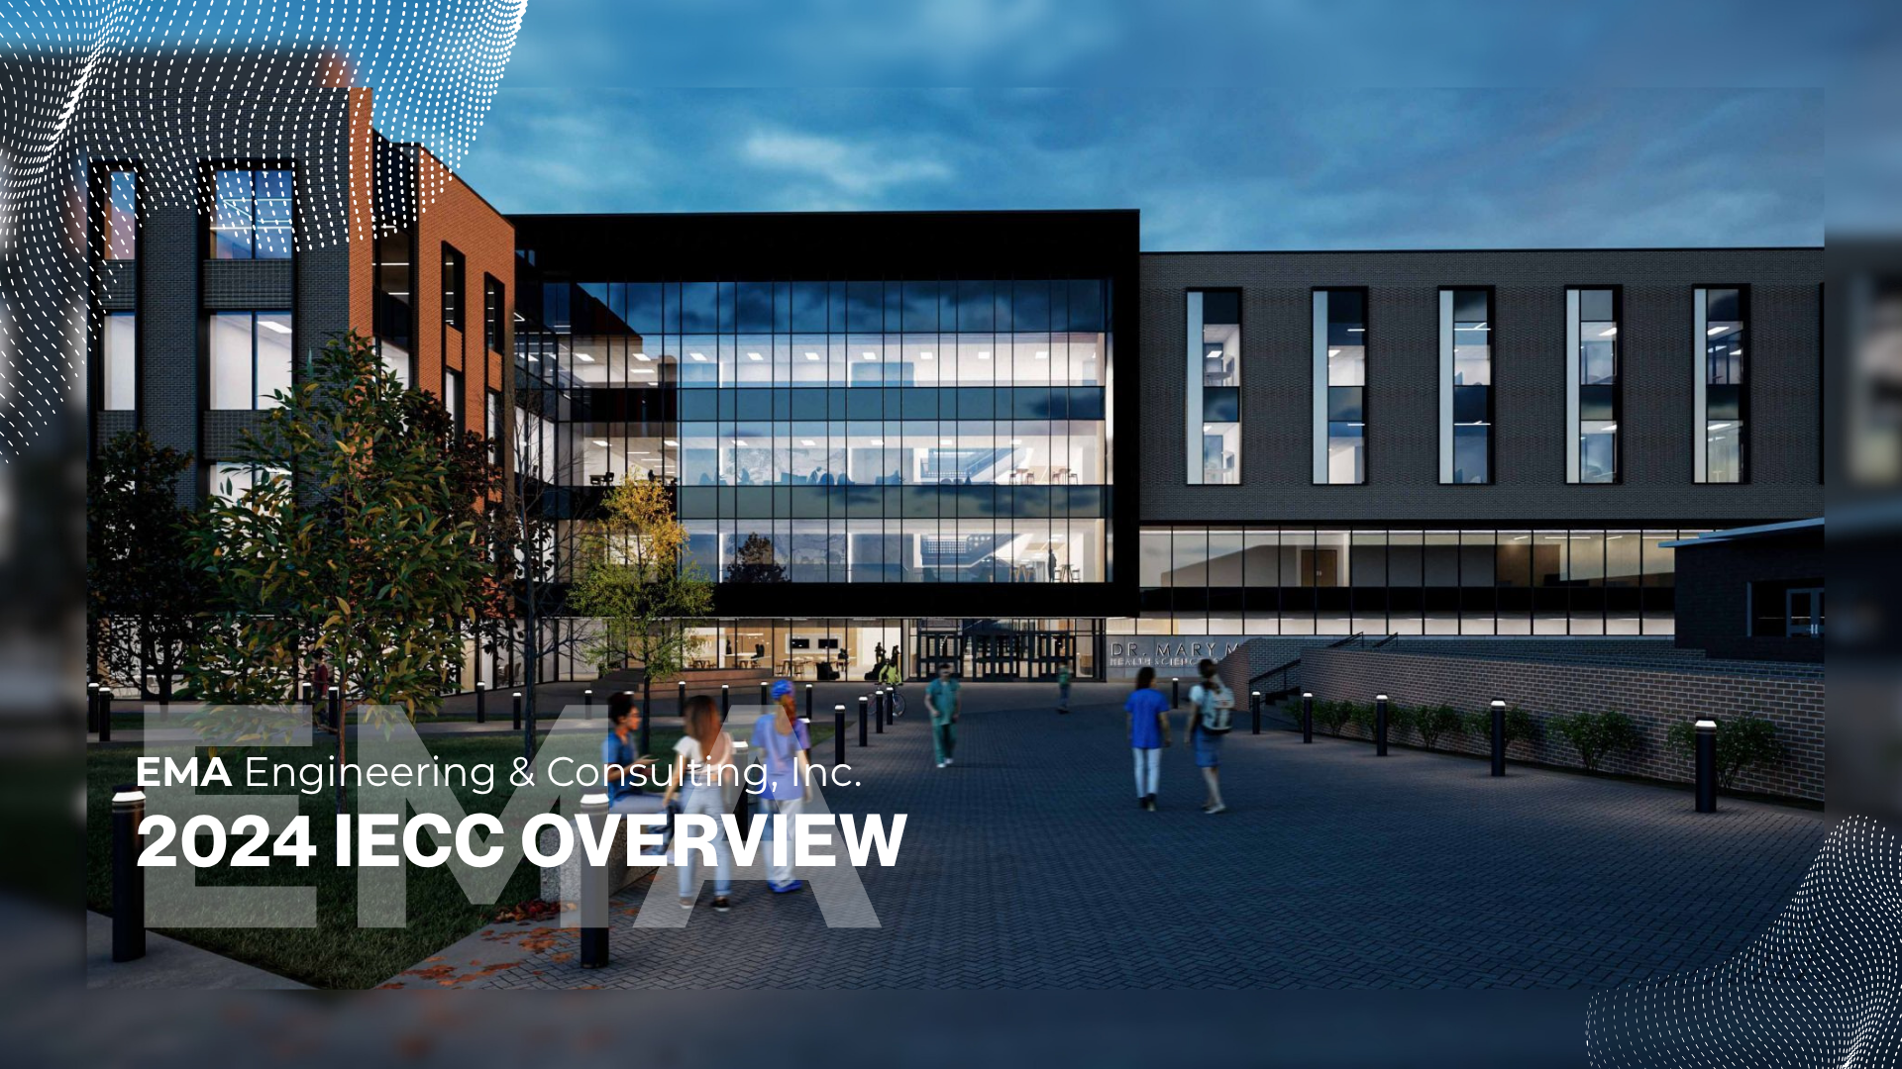

EMA Engineering & Consulting, Inc.
2024 IECC OVERVIEW

Slide 2

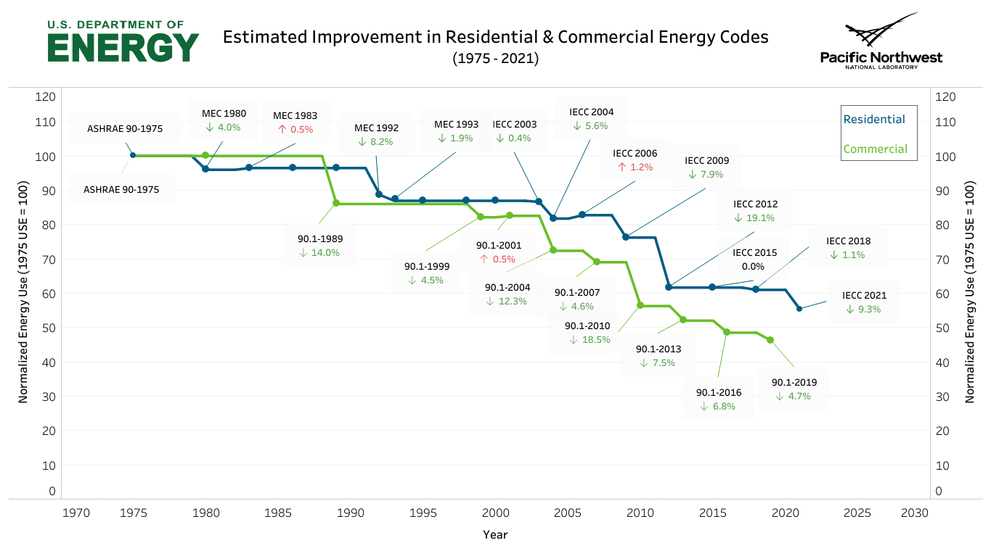


ESTIMATED IMPROVEMENT IN RESIDENTIAL & COMMERCIAL ENERGY CODES
(1975-2022)
IECC 2024
~6-8%

Slide 3


Slide 4
COMPLIANCE PATHS

Slide 5
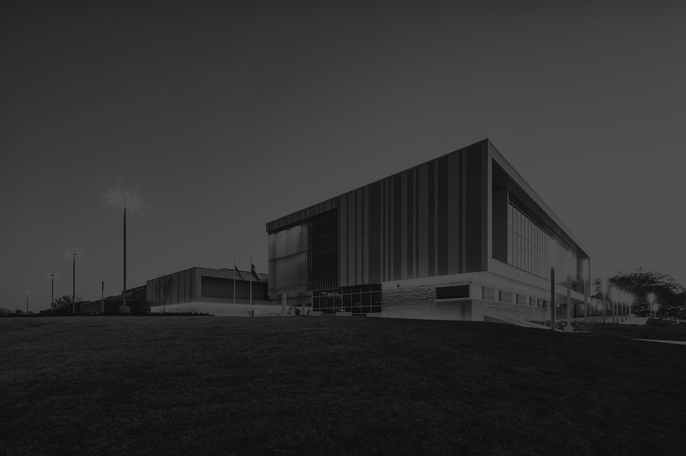


PRESCRIPTIVE COMPLIANCE
Requires compliance with all prescriptive & mandatory requirements.
Mandatory Requirements
UA Calculation & Lighting Tradeoffs
C406 Additional Efficiency Requirements Points
Section C402 - C406 and C408 (Cx)
2024 COMCheck is
now available!
New: Renewable and Load Management Requirements

Slide 6
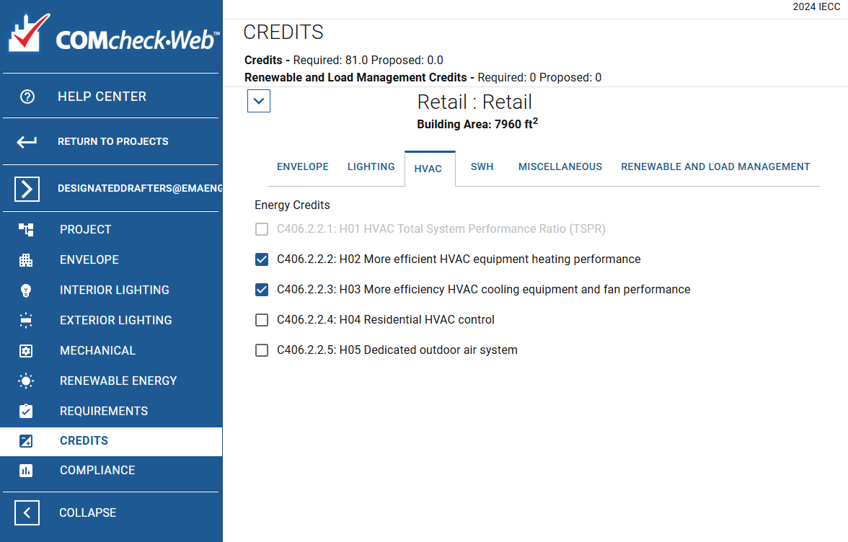
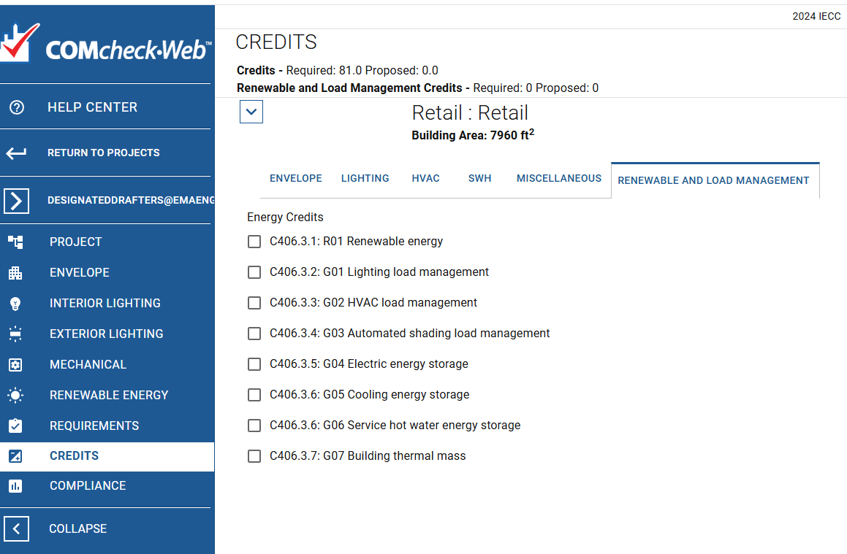
2024 COMCheck

Slide 7
SIMULATED PERFORMANCE PATH
C407 requires compliance with all mandatory requirements
Mandatory Requirements
Energy Model Required in Permit Submittal
Renewable & Load Management Credits
+ Sections referred in
Table C407.2 (1)
+ Trade-offs among the
various energy-using
systems of the building
+ Proposed design %
savings requirement
ranges from 21% to 25.6%
+ Need to be calculated
based on energy
efficiency points
required in C406

Slide 8
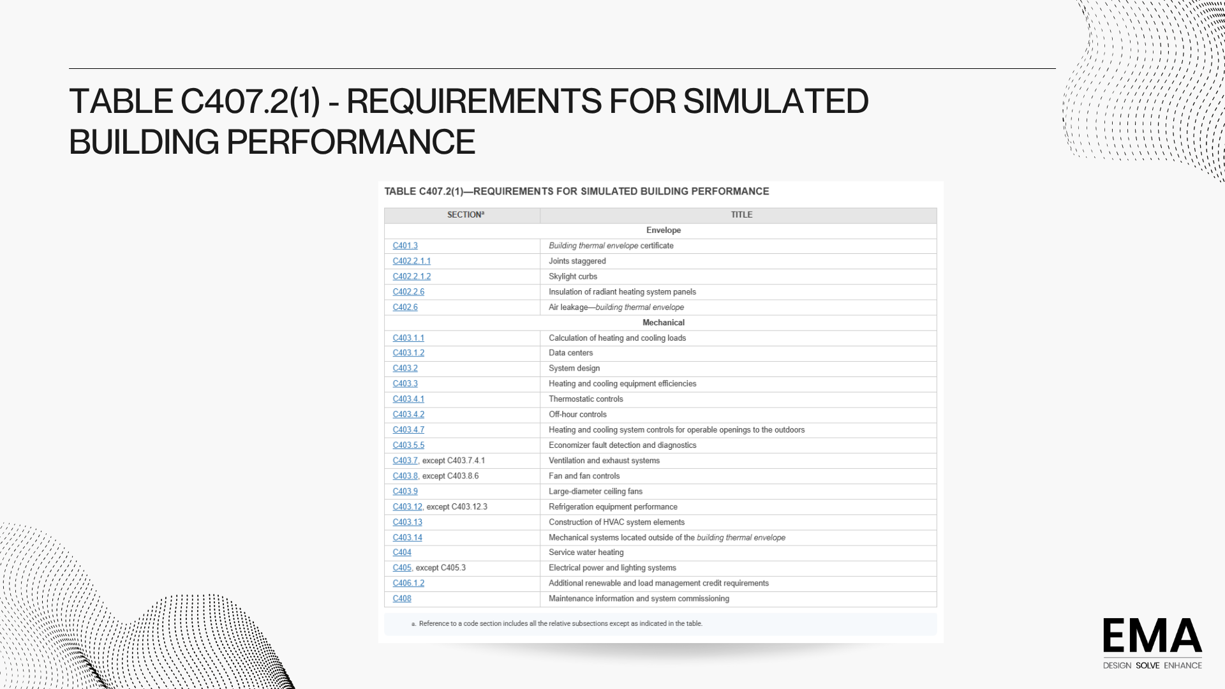

Slide 9
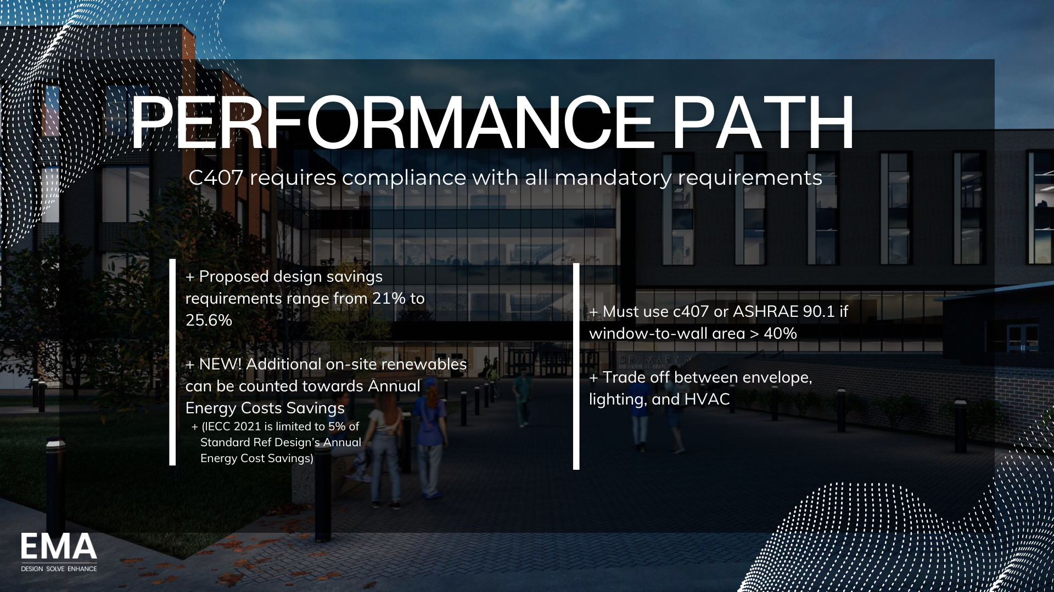

Slide 10
EFFICIENCY
CREDIT REQUIREMENTS

Slide 11
ADDITIONAL EFFICIENCY REQUIREMENTS POINTS
Snapshot
+ > 2,000 SF Conditioned Floor Area
+ C406.1.1
+ > 5,000 SF Conditioned Floor Area
+ C406.1.1
+ C406.1.2
+ Build Out Construction > SF Conditioned Floor Area
+ C406.1.1.2
Additional energy efficiency credit requirements
Additional energy efficiency credit
+
Additional renewable & load management credit

Slide 12
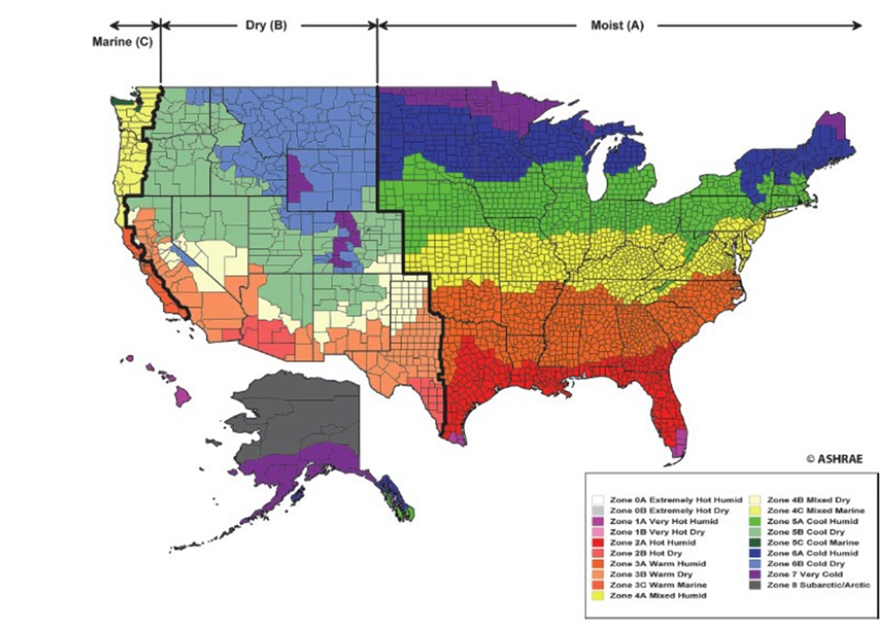
ADDI
ADDITIONAL EFFICIENCY REQUIREMENTS
+ Determined by Occupancy Group and
Climate Zone.
+ Comparison (e.g., Group B Occupancy in
2A Climate Zone)
+ Total Energy Credits Under 2021 IECC:
10
+ Total Energy Credits Under 2024 IECC:
111

Slide 13
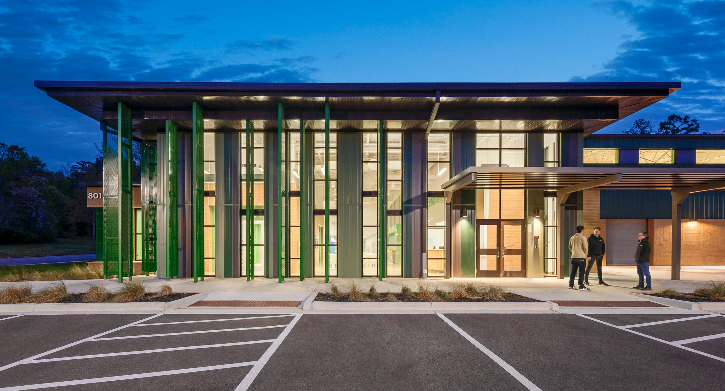

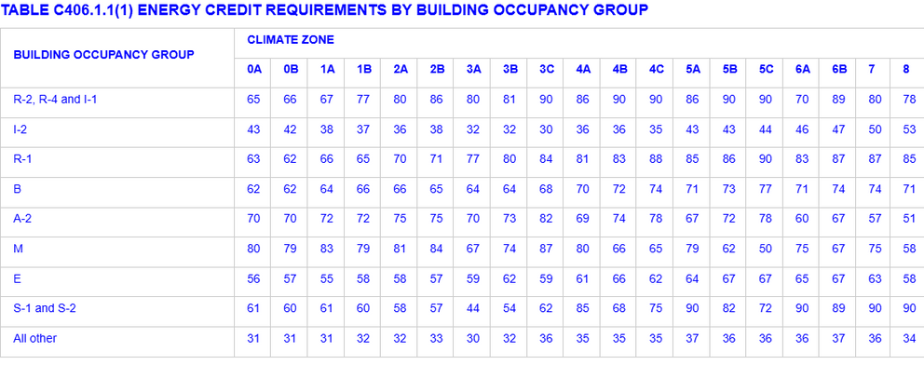
HOW MANY ADDITIONAL EFFICIENCY CREDITS DOES MY PROJECT NEED?
Scenario: Prescriptive path, School in Austin, 100,000 sq. ft. conditioned area, Natural Gas Heating, On-site Solar of 500kW, Lighting Load Management in 80% of building area with demand responsive lighting controls.
*Energy Credits

Slide 14
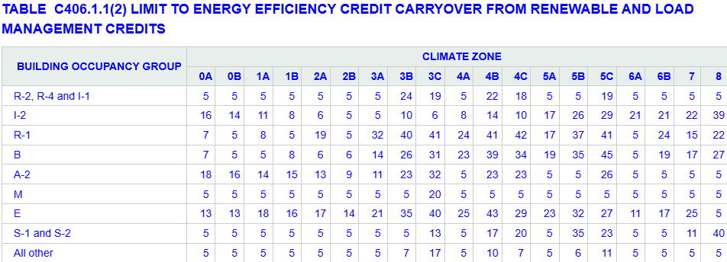
HOW MANY ADDITIONAL EFFICIENCY CREDITS DOES MY PROJECT NEED?
Scenario: Prescriptive path, School in Austin, 100,000 sq. ft. conditioned area, Natural Gas Heating, On-site Solar of 500kW, Lighting Load Management in 80% of building area with demand responsive lighting controls.
*Limit to EE credit carryover from renewable and load management credits

Slide 15
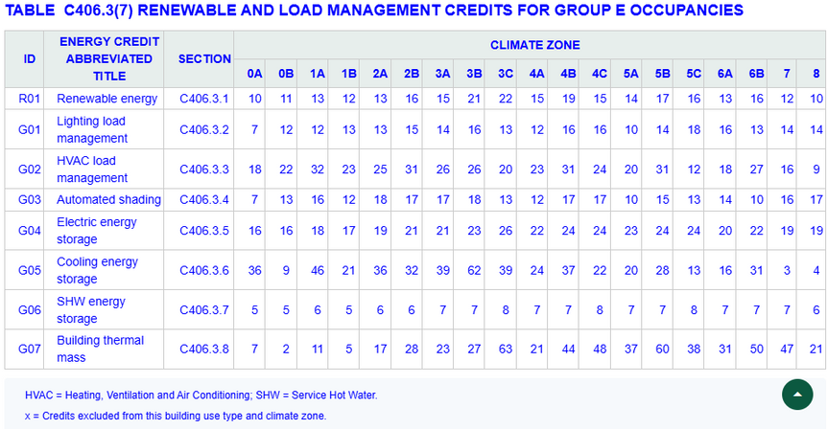
HOW MANY ADDITIONAL EFFICIENCY CREDITS DOES MY PROJECT NEED?
*Proposed: Renewable and Load Management Credits
Scenario: Prescriptive path, School in Austin, 100,000 sq. ft. conditioned area, Natural Gas Heating.
INPUT
On-site Solar of 500kW, Lightning Load Management in 80% of
building area with demand responsive lighting controls
Calculations per C406.3.1 AND C406.3.2
OUTPUT
INPUT

Slide 16
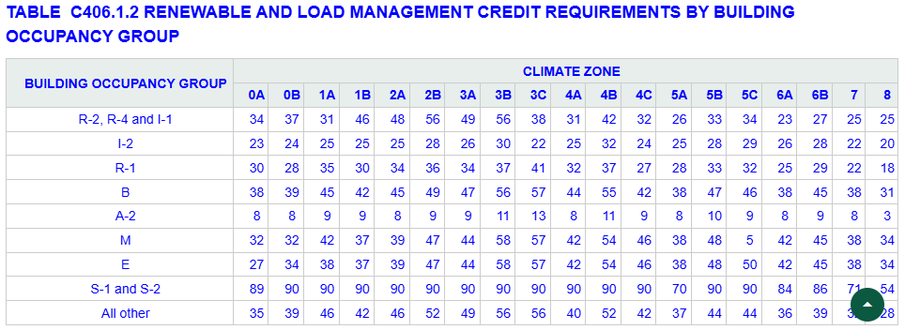


HOW MANY ADDITIONAL EFFICIENCY CREDITS DOES MY PROJECT NEED?
Scenario: Prescriptive path, School in Austin, 100,000 sq. ft. conditioned area, Natural Gas Heating.
*Required: Renewable and Load Management Credits
{
{
17
45
{
{
{
58
0.7 (for fossi fuels)
39

Slide 17
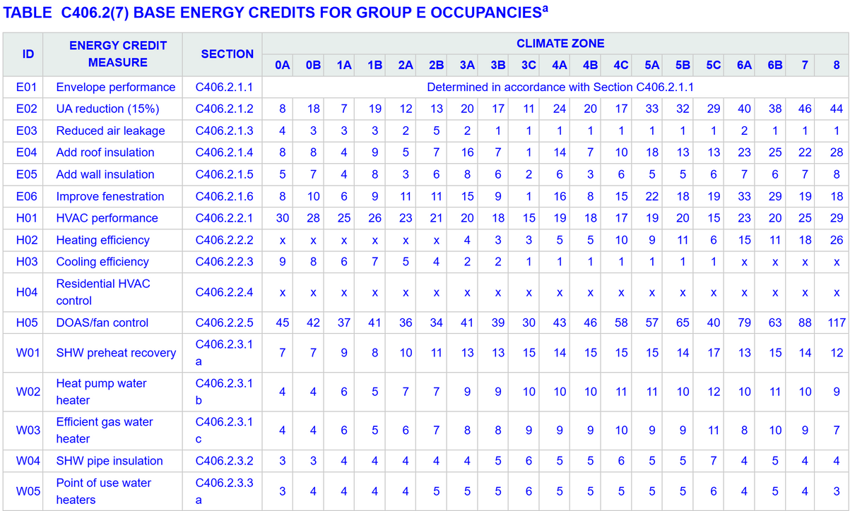
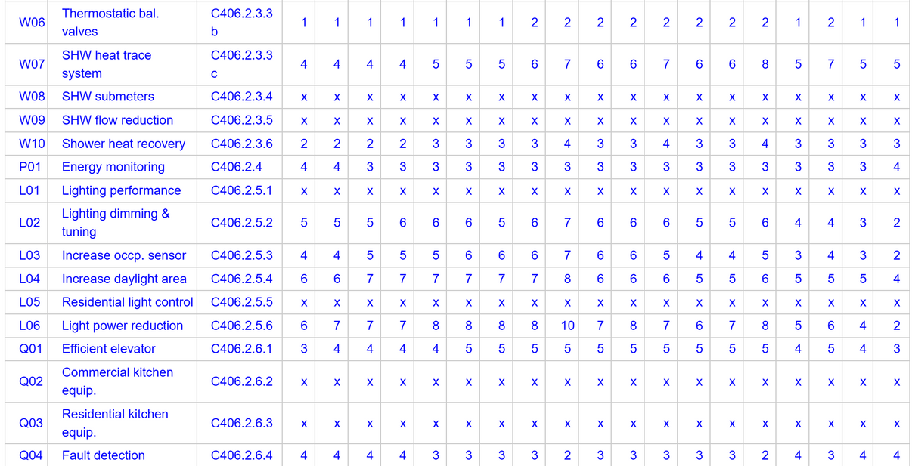
TOTAL BASE ENERGY CREDITS: 173
MEP-related Energy Credits:
+ Mechanical (64)
+ 5 options
+ Electrical (3)
+ 1 options
+ Lighting (26)
+ 10 options

Slide 18
BUILDING ENVELOPE

Slide 19
2024 Focused Items
Only for Prescriptive Path
Calculation required for through wall penetrations (louvers, refrigerant lines, conduits, etc).
If more than 1% of opaque above grade wall; Must be broken out as a separate wall assembly and meet envelope U-factor (default 0.5)
Area weighted method or component performance alternative method
+ Mechanical Penetration
+ Fenestration Allowance
+ Thermal Bridging
+ Envelope Testing

Slide 20
2024 Focused Items
Vertical fenestration <30% : Prescriptive path or Performance path
Vertical fenestration >30% & up to 40%: Need improved SHGC, U-factor + daylight responsive controls, component performance alternative
Still stays in prescriptive
2021 required either performance path or ASHRAE 90.1
Vertical fenestration >40%:
Simulated performance path OR
ASHRAE 90.1
+ Mechanical Penetration
+ Fenestration Allowance
+ Thermal Bridging
+ Envelope Testing

Slide 21
2024 Focused Items
2021 IECC: Did not address thermal bridging at the intersection of assemblies & components
2024 IECC: Added thermal bridging identification for:
Balconies: approved thermal break device, Penetration area within the area-weighted U-factor of above-grade wall, component alternative or performance path approach
Cladding Supports: offset from structure to allow for continuous insulation to pass behind cladding except at the support point
Beams & Columns: covered with R-5 for at least 2 ft
Vertical fenestrations: non-metal thermal break in the frame, R-3 for or wood buck at least 1.5 inches, accounted in U-factor calculation
Parapets: continuous insulation on both sides of parapet walls, cavity insulation
+ Mechanical Penetration
+ Fenestration Allowance
+ Thermal Bridging
+ Envelope Testing

Slide 22
2024 Focused Items
+ Mechanical Penetration
+ Fenestration Allowance
+ Thermal Bridging
+ Envelope Testing
Buildings > 25,000 sq ft on CZ0-4: exempt from air leakage testing
Reduced leakage allowance: 0.35 CFM/sq ft
Leakage allowance up to 0.45 CFM/sq ft, but requires corrective action
Building Envelope Performance Verification (Cx) Requirement (same as 2021 IECC)

Slide 23
MEP CHANGES

Slide 24
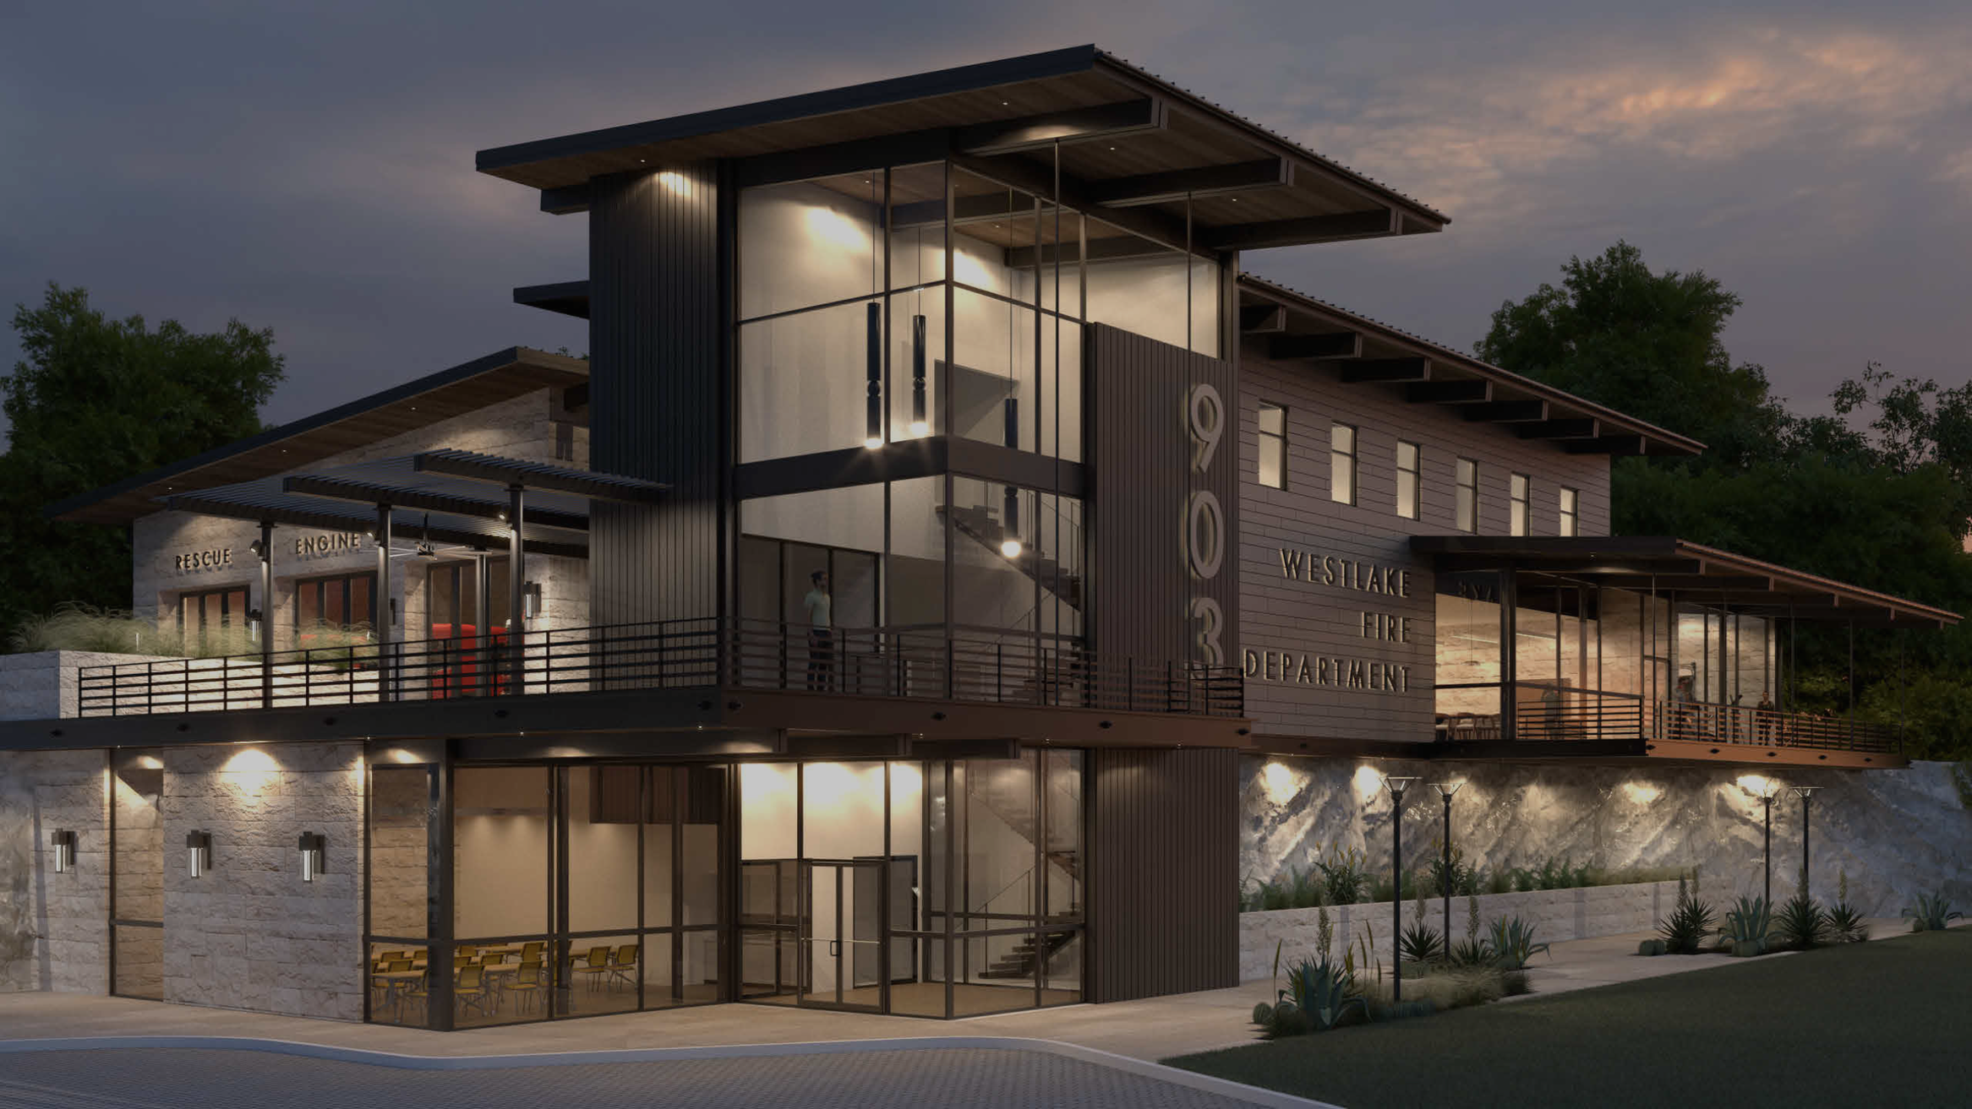
MECHANICAL
+ Sections C403.4.6 - C403.3.8, C403.7.8, C403.8.6.2,
added.
+ HVAC Efficiency table has been adjusted to match with ASHRAE 90.1-2022

Slide 25
C403.4.6 - C403.4.8
+ Door interlock requirement: expanded to 40 sf doors
between conditioned space and outdoors must
interlock with HVAC controls (i.e., disable heating or
cooling when open), not just large operable
openings.
+ Humidity limits: imposes upper and lower relative
humidity caps for spaces actively controlled for
humidity, intended to limit excessive energy use.
+ Prohibits sub-cooling of air for reducing humidity below the lower of 55F dew point or RH of 60% in the coldest zone.
(DOAS, DX with Hot-gas Reheat, ECM fan, multi-stage compressors)

Slide 26
C403.7.8
+ Requires “occupied standby” controls in certain
spaces: when zones aren’t occupied, HVAC systems
must be able to set back cooling/heating setpoints,
reduce supply air, and cut ventilation airflow to save
energy.

Slide 27
C403.8.6.2
+ Requires that exhaust fans in bathrooms and toilet
rooms must have intermittent control methods.
+ The automatic control requirement is waived if the
bathroom or toilet room is part of the outdoor air
ventilation system for Group R‑2, R‑3, or R‑4
occupancies. In those cases, only a manual “on”
override is required.

Slide 28
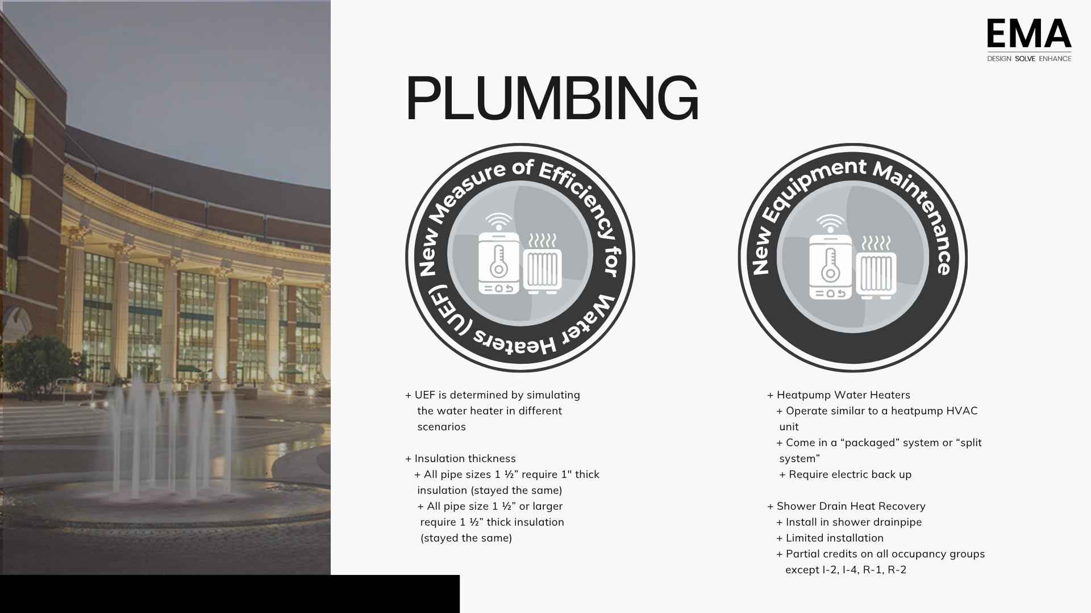

Slide 29
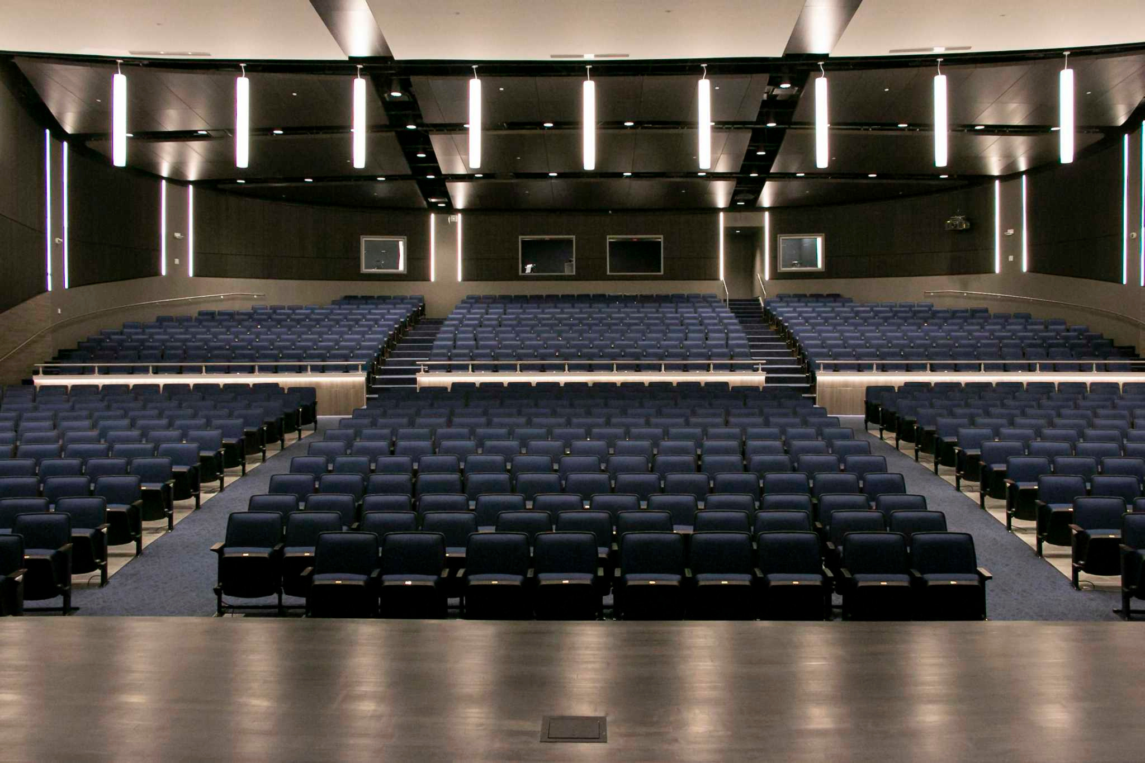
LIGHTING
Occupancy
Sensors
Allowable
Wattage
Sleeping & Dwelling Units
+ Occupancy sensors
iii required in a few new
iiiareas.
+ Computer rooms, data
centers, laundry rooms,
medical supply rooms,
telemedicine rooms.
+ Mandatory Continuous Dimming Controls added.
+ Allowable wattage for
general lighting within
daylight zones has been
reduced by half
150W to 75W in a single primary zone.
+ Sleeping units and
iiiidwelling units to have
iiiilighting controls and
iii switched receptacles

Slide 30
ELECTRICAL
UTILITY METERING
ONSITE RENEWABLE ENERGY
ENERGY CREDITS
Now applies to commercial buildings ≥ 10,000 sq. ft. (was 25,000 sq. ft.).
Includes non-electrical utilities (natural gas, propane, fuel oil, etc.) must be metered by load category (C405.13.8).
New buildings (including additions) are required to generate renewable energy in the amount of 0.75 Watts for every sq. ft. of conditioned floor area, not to exceed the conditioned floor area for the three largest floors (C405.15.1)
The number of required Energy Efficiency Credits have increased in the 2024 code (C406.1.1).
Newly added Renewable and Load Management (RLM) credit requirements (C406.3).

Slide 31
ELECTRICAL
ON-SITE RENEWABLE ENERGY SYSTEMS
ON-SITE RENEWABLE ENERGY SYSTEM – FOUR EXCEPTIONS
On-Site Renewable Energy Requirements
New commercial buildings ≥ 5,000 sq. ft. must incorporate an on-site renewable energy generation system with a minimum DC generating capacity of:
DC size = Conditioned Floor Area×0.75
Exceptions to On-Site Renewable Energy Installation
An on-site renewable energy system is not required if the building or site meets one of the following four exceptions:
Low Solar Radiation
The site receives an annual daily average incident solar radiation of < 3.5 kWh/m²/day.
Typically applies to northernmost states; Texas and surrounding states exceed 4 kWh/m²/day.
Roof Obstructions Covering ≥ 80% of Roof Area
Includes mechanical equipment, vents, drains, skylights, and access pathways.
This is an exception where the design can influence its application.
Shading from External Objects for > 2,500 Hours/Year
More than 50% of the roof area is shaded by trees or neighboring structures between 8 AM and 4 PM.
Might apply for short buildings near tall trees/structures; requires a shading analysis to qualify.
Small Building Size
Buildings < 5,000 sq. ft. of conditioned floor area

Slide 32
ELECTRICAL
Off-Site Renewable Energy Procurement Requirements
If the building does qualify for an exception, the owner must procure off-site renewable energy per C405.15.2:
Option 1: A 10-year minimum energy contract (C405.15.2.2).
Option 2: If a contract is not available, the owner must purchase renewable electricity products equal to 5 times the required off-site renewable energy amount before the certificate of occupancy is issued (C405.15.4).

Slide 33
ELECTRICAL
Demand Responsive (DR) Controls:
New requirements were added for Demand Responsive (DR) lighting controls, which must be capable of automatically reducing lighting output to 80% or less upon receiving a demand response signal.
DRLC systems function by communicating with the utility grid to receive a signal—the demand response signal—that indicates a period of high grid stress, a high wholesale price for electricity, or another request to temporarily reduce power usage.
Receipt of DR Signal:
The building's control system (often a Building Management System or a dedicated lighting controller) receives the OpenADR (Open Automated Demand Response) signal, which is a standardized communication protocol.
Automated Curtailment:
Upon receiving the signal, the DRLC system automatically reduces the power consumption of the controlled lighting. This is typically done through continuous dimming rather than switching lights off completely in occupied spaces, to minimize disruption to occupants.

Slide 34
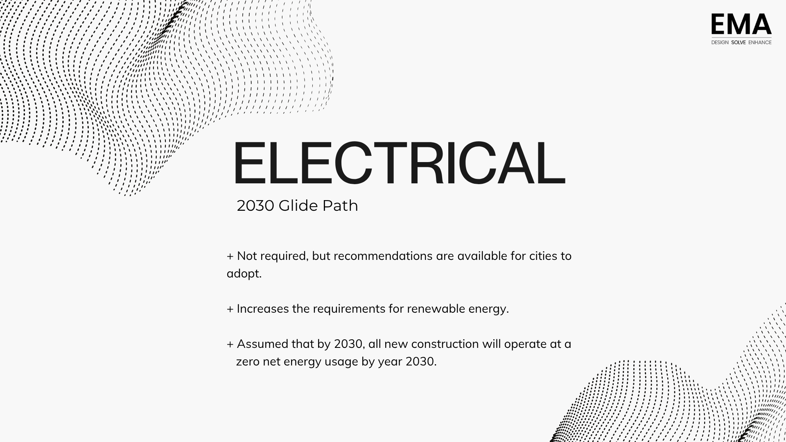

Slide 35


